Slide 1
高等机器学习
Advanced Machine Learning
§1.2 神经网络表示
Representation for Neural Networks
滕佳烨
上海财经大学
www.tengjiaye.com
高等机器学习 Advanced Machine Learning
神经网络表示 Representation for Neural Networks
滕佳烨 Jiaye Teng, 上海财经大学 SUFE

Slide 2
Recall
Universal approximation theory
Neural Networks with sufficiently large width approximates any function
Usually requires exponentially many neurons
Neural networks with different depth
Separation between two-layer and three-layer neural networks
Today
Representation and neural network properties
A Universal Law of Robustness via Isoperimetry. Sébastien Bubeck, Mark Sellke. https://arxiv.org/abs/2105.12806
高等机器学习 Advanced Machine Learning
神经网络表示 Representation for Neural Networks
滕佳烨 Jiaye Teng, 上海财经大学 SUFE

Slide 3
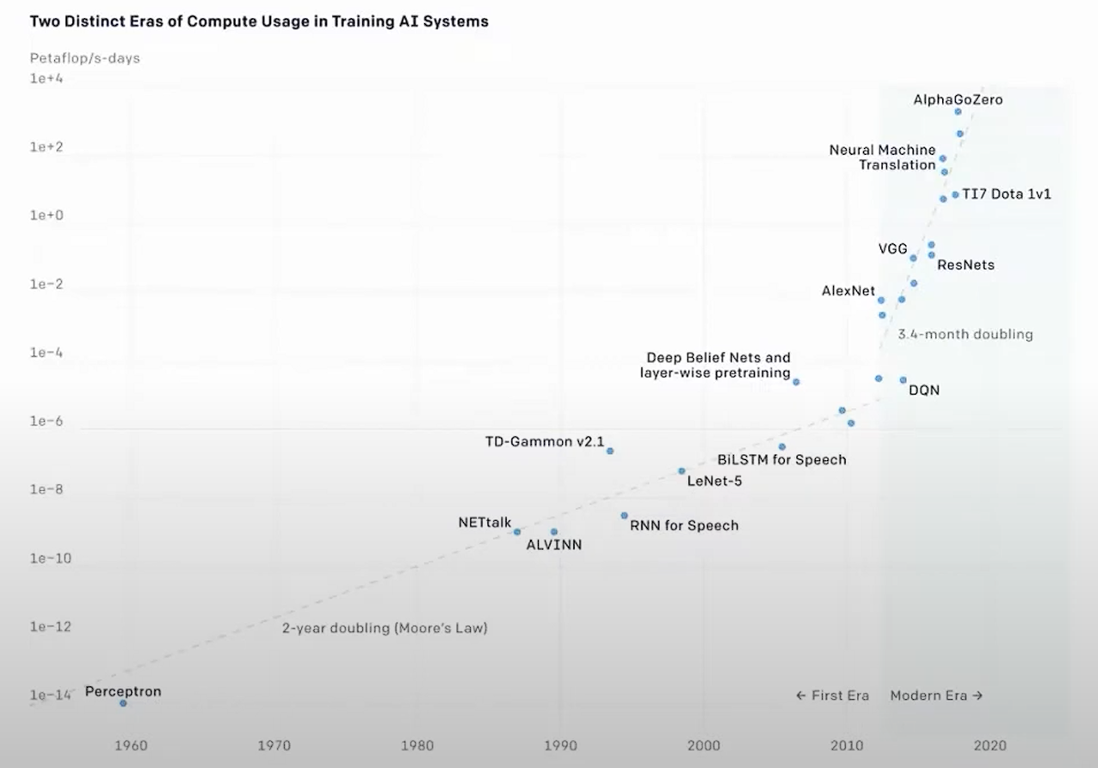
Overparameterization in Neural Networks
In neural networks, # training samples << # parameters
For size of neural network, bigger is better, generally speaking :)
高等机器学习 Advanced Machine Learning
神经网络表示 Representation for Neural Networks
滕佳烨 Jiaye Teng, 上海财经大学 SUFE

Slide 4
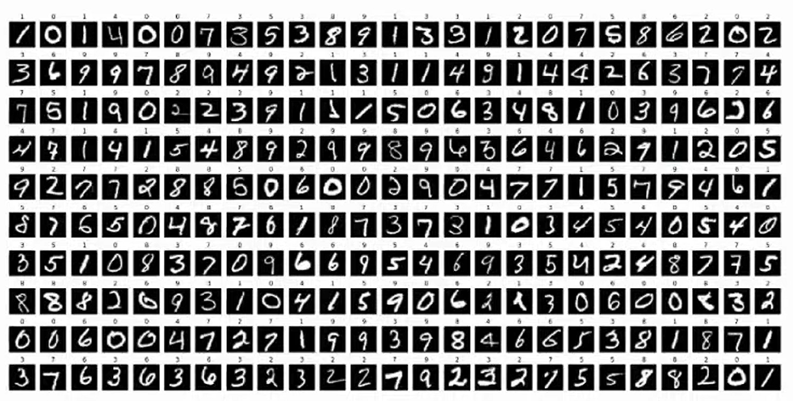
Overparameterization in Neural Networks
In neural networks, # training samples << # parameters
Take the example of MNIST, $n=6×{10}^{4}$ images. However in real world, typical model trains $p={10}^{6}$ parameters
高等机器学习 Advanced Machine Learning
神经网络表示 Representation for Neural Networks
滕佳烨 Jiaye Teng, 上海财经大学 SUFE

Slide 5
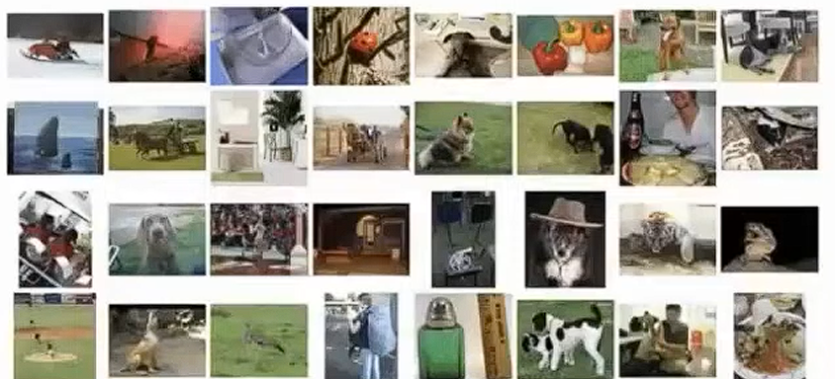
Overparameterization in Neural Networks
In neural networks, # training samples << # parameters
Take the example of ImageNet with $n=6×{10}^{6}$ images. Each of them have $d={10}^{5}$pixels. And a typical model trains $p={10}^{9}$parameters
高等机器学习 Advanced Machine Learning
神经网络表示 Representation for Neural Networks
滕佳烨 Jiaye Teng, 上海财经大学 SUFE

Slide 6
Overparameterization in Neural Networks
In neural networks, # training samples << # parameters
Question: why we need so many parameters?
Note: the representation power (zero training loss) could be usually achieved when # training samples = # parameters
高等机器学习 Advanced Machine Learning
神经网络表示 Representation for Neural Networks
滕佳烨 Jiaye Teng, 上海财经大学 SUFE

Slide 7
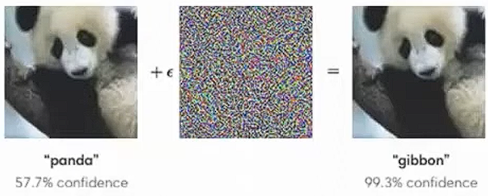

Robustness in Neural Networks
Robustness represents model performance when adding small perturbation
Lipschitz neural networks could guarantee robustness
$$‖f\left(x\right)−f\left(x+Δ\right)‖≤L‖Δ‖.$$
$L$: Lipschitz Constant
Original
Image
Perturbated
Image
Small
Differences
高等机器学习 Advanced Machine Learning
神经网络表示 Representation for Neural Networks
滕佳烨 Jiaye Teng, 上海财经大学 SUFE

Slide 8


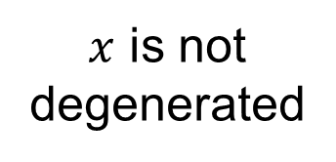
Main Results in this paper (proof)
$x$ is not degenerated
Noise Fitting leads to a large Lipschitz
(Bad Robustness)
高等机器学习 Advanced Machine Learning
神经网络表示 Representation for Neural Networks
滕佳烨 Jiaye Teng, 上海财经大学 SUFE

Slide 9

Main Results in this paper (proof)
$$ℙ\left(∃f∈ℱ:\frac{1}{n}∑{\left(y_{i}−f\left(x_{i}\right)\right)}^{2}≤σ^{2}−ε\right)$$
Prove that this prob is small with limited Lipschitz
高等机器学习 Advanced Machine Learning
神经网络表示 Representation for Neural Networks
滕佳烨 Jiaye Teng, 上海财经大学 SUFE

Slide 10

Main Results in this paper (proof)
$$ℙ\left(∃f∈ℱ:\frac{1}{n}∑{\left(y_{i}−f\left(x_{i}\right)\right)}^{2}≤σ^{2}−ε\right)$$
Prove that this prob is small with limited Lipschitz
$$ℙ\left(∃f∈ℱ:\frac{1}{n}∑{\left(z_{i}−f\left(x_{i}\right)\right)}^{2}≤σ^{2}−ε\right)$$
[1] Assume that $y$ is pure bounded noise $z$ to simplify the discussion
高等机器学习 Advanced Machine Learning
神经网络表示 Representation for Neural Networks
滕佳烨 Jiaye Teng, 上海财经大学 SUFE

Slide 11

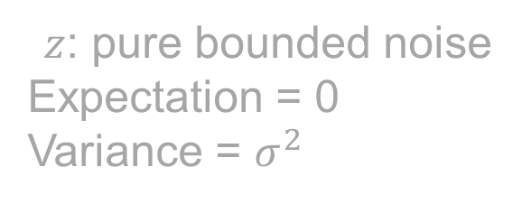
Main Results in this paper (proof)
$$ℙ\left(∃f∈ℱ:\frac{1}{n}∑{\left(z_{i}−f\left(x_{i}\right)\right)}^{2}≤σ^{2}−ε\right)$$
$z$: pure bounded noise
Expectation = 0
Variance = $σ^{2}$
$$z_{i}^{2}−2z_{i}f\left(x_{i}\right)+f^{2}(x_{i})$$
高等机器学习 Advanced Machine Learning
神经网络表示 Representation for Neural Networks
滕佳烨 Jiaye Teng, 上海财经大学 SUFE

Slide 12

Main Results in this paper (proof)
$$ℙ\left(∃f∈ℱ:\frac{1}{n}∑{\left(z_{i}−f\left(x_{i}\right)\right)}^{2}≤σ^{2}−ε\right)$$
$z$: pure bounded noise
Expectation = 0
Variance = $σ^{2}$
$$z_{i}^{2}−2z_{i}f\left(x_{i}\right)+f^{2}(x_{i})$$
$$≈σ^{2}$$
(Hoeffding Ineq)
高等机器学习 Advanced Machine Learning
神经网络表示 Representation for Neural Networks
滕佳烨 Jiaye Teng, 上海财经大学 SUFE

Slide 13

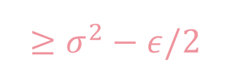
Main Results in this paper (proof)
$$ℙ\left(∃f∈ℱ:\frac{1}{n}∑{\left(z_{i}−f\left(x_{i}\right)\right)}^{2}≤σ^{2}−ε\right)$$
$z$: pure bounded noise
Expectation = 0
Variance = $σ^{2}$
$$z_{i}^{2}−2z_{i}f\left(x_{i}\right)+f^{2}(x_{i})$$
$$≈σ^{2}$$
$$≥σ^{2}−ε/2$$
$$≥0$$
高等机器学习 Advanced Machine Learning
神经网络表示 Representation for Neural Networks
滕佳烨 Jiaye Teng, 上海财经大学 SUFE

Slide 14
Main Results in this paper (proof)
$$ℙ\left(∃f∈ℱ:\frac{1}{n}∑{\left(z_{i}−f\left(x_{i}\right)\right)}^{2}≤σ^{2}−ε\right)$$
$z$: pure bounded noise
Expectation = 0
Variance = $σ^{2}$
$$z_{i}^{2}−2z_{i}f\left(x_{i}\right)+f^{2}(x_{i})$$
$$≈σ^{2}$$
$$≥σ^{2}−ε/2$$
$$≥0$$
Note: Constant is not important here
高等机器学习 Advanced Machine Learning
神经网络表示 Representation for Neural Networks
滕佳烨 Jiaye Teng, 上海财经大学 SUFE

Slide 15
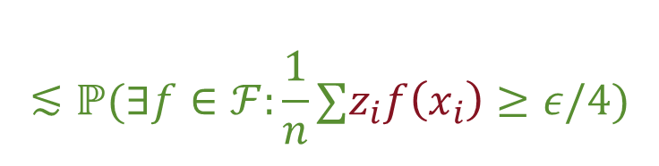

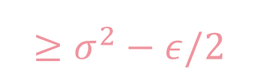
Main Results in this paper (proof)
$$ℙ\left(∃f∈ℱ:\frac{1}{n}∑{\left(z_{i}−f\left(x_{i}\right)\right)}^{2}≤σ^{2}−ε\right)$$
$$≲ℙ(∃f∈ℱ:\frac{1}{n}∑z_{i}f\left(x_{i}\right)≥ε/4)$$
$$z_{i}^{2}−2z_{i}f\left(x_{i}\right)+f^{2}(x_{i})$$
$$≥σ^{2}−ε/2$$
$$≥0$$
Note: Constant is not important here
高等机器学习 Advanced Machine Learning
神经网络表示 Representation for Neural Networks
滕佳烨 Jiaye Teng, 上海财经大学 SUFE

Slide 16
Main Results in this paper (proof)
$$ℙ(∃f∈ℱ:\frac{1}{n}∑z_{i}f\left(x_{i}\right)≥ε/4)$$
[1] Assume that $y$ is pure bounded noise $z$ to simplify the discussion
高等机器学习 Advanced Machine Learning
神经网络表示 Representation for Neural Networks
滕佳烨 Jiaye Teng, 上海财经大学 SUFE

Slide 17

Main Results in this paper (proof)
$$ℙ(∃f∈ℱ:\frac{1}{n}∑z_{i}f\left(x_{i}\right)≥ε/4)$$
Step 1: for a fixed $f$, the probability is small
Step 2: restricts the function class complexity
高等机器学习 Advanced Machine Learning
神经网络表示 Representation for Neural Networks
滕佳烨 Jiaye Teng, 上海财经大学 SUFE

Slide 18
Main Results in this paper (proof)
$$ℙ(∃f∈ℱ:\frac{1}{n}∑z_{i}f\left(x_{i}\right)≥ε/4)$$
Step 1: for a fixed $f$, the probability is small
Insight: $z$ is bounded, $x_{i}$ is isoperimetry, therefore $f(x_{i})$ is subGaussian [2]
[2] High-dimensional Probability, Theorem 5.1.4. Assume that $x_{i}$ on sphere for simplicity
高等机器学习 Advanced Machine Learning
神经网络表示 Representation for Neural Networks
滕佳烨 Jiaye Teng, 上海财经大学 SUFE

Slide 19


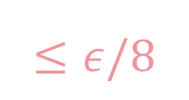
Main Results in this paper (proof)
$$ℙ(∃f∈ℱ:\frac{1}{n}∑z_{i}f\left(x_{i}\right)≥ε/4)$$
Step 1: for a fixed $f$, the probability is small
Insight: $z$ is bounded, $x_{i}$ is isoperimetry, therefore $f(x_{i})$ is subGaussian [2]
$$\frac{1}{n}∑z_{i}\left[f\left(x_{i}\right)−𝔼f\left(x_{i}\right)\right]+\frac{1}{n}𝔼f\left(x_{i}\right)∑z_{i}$$
$z$ is bounded (subGaussian)
$$≈0$$
$$≤ε/8$$
[2] High-dimensional Probability, Theorem 5.1.4. Assume that $x_{i}$ on sphere for simplicity
高等机器学习 Advanced Machine Learning
神经网络表示 Representation for Neural Networks
滕佳烨 Jiaye Teng, 上海财经大学 SUFE

Slide 20

Main Results in this paper (proof)
$$ℙ(∃f∈ℱ:\frac{1}{n}∑z_{i}f\left(x_{i}\right)≥ε/4)$$
Step 1: for a fixed $f$, the probability is small
Insight: $z$ is bounded, $x_{i}$ is isoperimetry, therefore $f(x_{i})$ is subGaussian [2]
$$ℙ\left(∃f∈ℱ:\frac{1}{n}∑z_{i}\left[f\left(x_{i}\right)−𝔼f\left(x_{i}\right)\right]≥8/ε\right)$$
[2] High-dimensional Probability, Theorem 5.1.4. Assume that $x_{i}$ on sphere for simplicity
高等机器学习 Advanced Machine Learning
神经网络表示 Representation for Neural Networks
滕佳烨 Jiaye Teng, 上海财经大学 SUFE

Slide 21

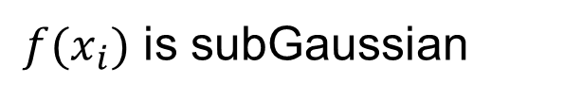


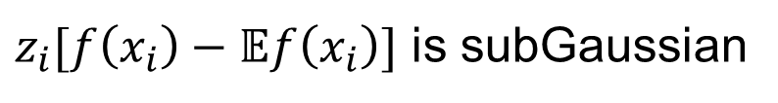
Main Results in this paper (proof)
$$ℙ\left(∃f∈ℱ:\frac{1}{n}∑z_{i}\left[f\left(x_{i}\right)−𝔼f\left(x_{i}\right)\right]≥ε/8\right)$$
Step 1: for a fixed $f$, the probability is small
Insight: $z$ is bounded, $x_{i}$ is isoperimetry, therefore $f(x_{i})$ is subGaussian [2]
$z$ is bounded
$z_{i}[f\left(x_{i}\right)−𝔼f\left(x_{i}\right)]$ is subGaussian
$f(x_{i})$ is subGaussian
$$ℙ\left(\frac{1}{n}∑z_{i}\left[f\left(x_{i}\right)−𝔼f\left(x_{i}\right)\right]≥ε/8\right)≤\exp\left(−\frac{ε^{2}nd}{cL^{2}}\right).$$
[2] High-dimensional Probability, Theorem 5.1.4. Assume that $x_{i}$ on sphere for simplicity
高等机器学习 Advanced Machine Learning
神经网络表示 Representation for Neural Networks
滕佳烨 Jiaye Teng, 上海财经大学 SUFE

Slide 22
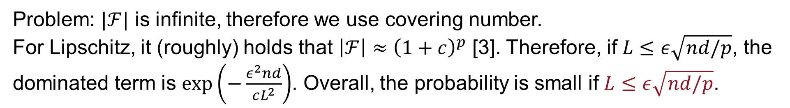

Main Results in this paper (proof)
$$ℙ\left(∃f∈ℱ:\frac{1}{n}∑z_{i}\left[f\left(x_{i}\right)−𝔼f\left(x_{i}\right)\right]≥ε/8\right)$$
Step 2: there exists a $f∈ℱ$: Union bound with covering number
$$ℙ\left(∃f∈ℱ:\frac{1}{n}∑z_{i}\left[f\left(x_{i}\right)−𝔼f\left(x_{i}\right)\right]≥ε/8\right)≤|ℱ|\exp\left(−\frac{ε^{2}nd}{cL^{2}}\right).$$
Problem: $|ℱ|$ is infinite, therefore we use covering number.
For Lipschitz, it (roughly) holds that $\left|ℱ\right|≈{\left(1+c\right)}^{p}$ [3]. Therefore, if $L≤ε\sqrt{nd/p}$, the dominated term is $\exp\left(−\frac{ε^{2}nd}{cL^{2}}\right)$. Overall, the probability is small if $L≤ε\sqrt{nd/p}$.
[3] High-dimensional Probability, Corollary 4.2.13
高等机器学习 Advanced Machine Learning
神经网络表示 Representation for Neural Networks
滕佳烨 Jiaye Teng, 上海财经大学 SUFE

Slide 23
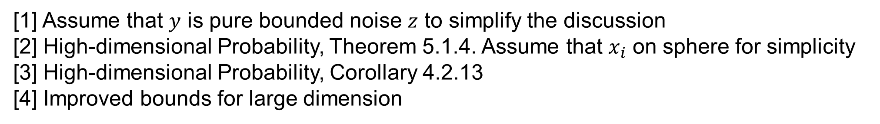
Remaining Parts
[1] Assume that $y$ is pure bounded noise $z$ to simplify the discussion
[2] High-dimensional Probability, Theorem 5.1.4. Assume that $x_{i}$ on sphere for simplicity
[3] High-dimensional Probability, Corollary 4.2.13
[4] Improved bounds for large dimension
高等机器学习 Advanced Machine Learning
神经网络表示 Representation for Neural Networks
滕佳烨 Jiaye Teng, 上海财经大学 SUFE

Slide 24

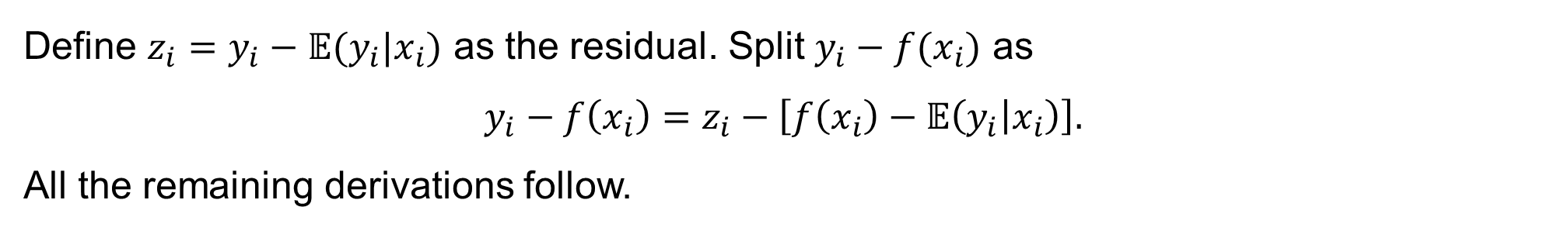

Remaining Parts
[1] Assume that $y$ is pure bounded noise $z$ to simplify the discussion
$$ℙ\left(∃f∈ℱ:\frac{1}{n}∑{\left(y_{i}−f\left(x_{i}\right)\right)}^{2}≤σ^{2}−ε\right)$$
$$ℙ\left(∃f∈ℱ:\frac{1}{n}∑{\left(z_{i}−f\left(x_{i}\right)\right)}^{2}≤σ^{2}−ε\right)$$
Define $z_{i}=y_{i}−𝔼(y_{i}|x_{i})$ as the residual. Split $y_{i}−f(x_{i})$ as
$$y_{i}−f\left(x_{i}\right)=z_{i}−\left[f\left(x_{i}\right)−𝔼\left(y_{i} | x_{i}\right)\right].$$
All the remaining derivations follow.
Besides, $z_{i}$ is bounded since $y$ is bounded.
高等机器学习 Advanced Machine Learning
神经网络表示 Representation for Neural Networks
滕佳烨 Jiaye Teng, 上海财经大学 SUFE

Slide 25
Remaining Parts
[2] High-dimensional Probability, Theorem 5.1.4. Assume that $x_{i}$ on sphere for simplicity
Isoperimetry: $x$ is isoperimetry, then $f(x)$ is subGaussian when $f$ is Lipschitz.
Uniform distribution over sphere satisfies isoperimetry
高等机器学习 Advanced Machine Learning
神经网络表示 Representation for Neural Networks
滕佳烨 Jiaye Teng, 上海财经大学 SUFE

Slide 26
Remaining Parts
[2] High-dimensional Probability, Theorem 5.1.4. Assume that $x_{i}$ on sphere for simplicity
Mixed isoperimetry (assumption 1)
A trivial extension. Since conditional on each k, the Hoeffding inequality still hold.
Analysis within each group, and then combine them (Page 7-8)
高等机器学习 Advanced Machine Learning
神经网络表示 Representation for Neural Networks
滕佳烨 Jiaye Teng, 上海财经大学 SUFE

Slide 27
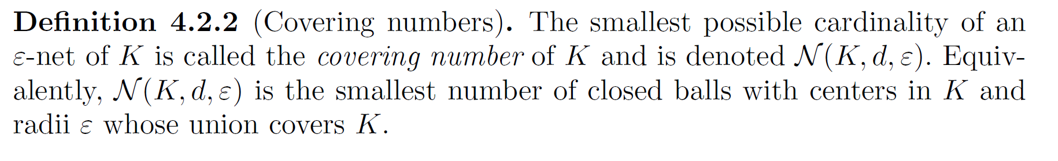
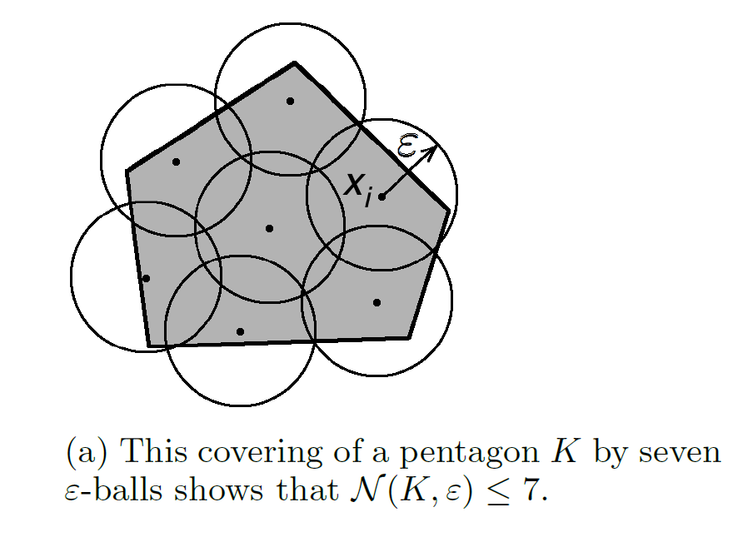
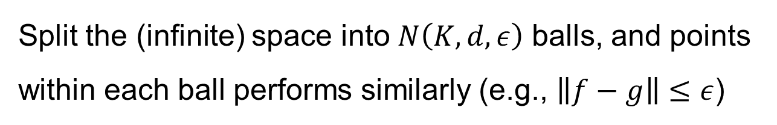
Remaining Parts
[3] High-dimensional Probability, Corollary 4.2.13 Covering Number
Covering Number: a popular technique from infinite class to finite class
Split the (infinite) space into $N\left(K,d,ε\right)$ balls, and points within each ball performs similarly (e.g., $\left\|f−g\right\|≤ε$)
[ref] High-dimensional Probability. Figure 4.1
高等机器学习 Advanced Machine Learning
神经网络表示 Representation for Neural Networks
滕佳烨 Jiaye Teng, 上海财经大学 SUFE

Slide 28

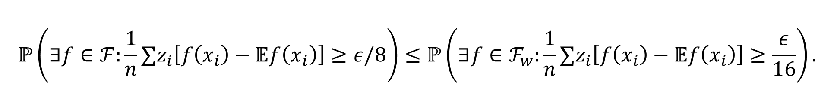

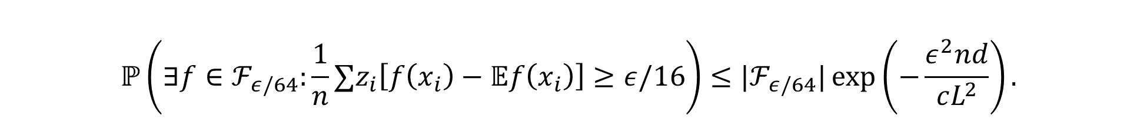


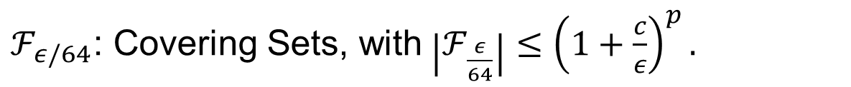
Remaining Parts
[3] High-dimensional Probability, Corollary 4.2.13 Covering Number
$$ℙ\left(∃f∈ℱ_{ε/64}:\frac{1}{n}∑z_{i}\left[f\left(x_{i}\right)−𝔼f\left(x_{i}\right)\right]≥ε/16\right)≤|ℱ_{ε/64}|\exp\left(−\frac{ε^{2}nd}{cL^{2}}\right).$$
$$ℙ\left(∃f∈ℱ:\frac{1}{n}∑z_{i}\left[f\left(x_{i}\right)−𝔼f\left(x_{i}\right)\right]≥ε/8\right)≤ℙ\left(∃f∈ℱ_{w}:\frac{1}{n}∑z_{i}\left[f\left(x_{i}\right)−𝔼f\left(x_{i}\right)\right]≥\frac{ε}{16}\right).$$
$$ε/64$$
$$ε/64$$
$$2$$
$$ε/16$$
$ℱ_{ε/64}$: Covering Sets, with$\left|ℱ_{\frac{ε}{64}}\right|≤{\left(1+\frac{c}{ε}\right)}^{p}.$
高等机器学习 Advanced Machine Learning
神经网络表示 Representation for Neural Networks
滕佳烨 Jiaye Teng, 上海财经大学 SUFE

Slide 29

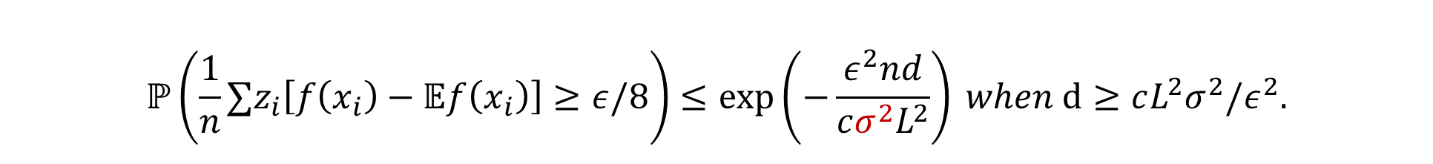
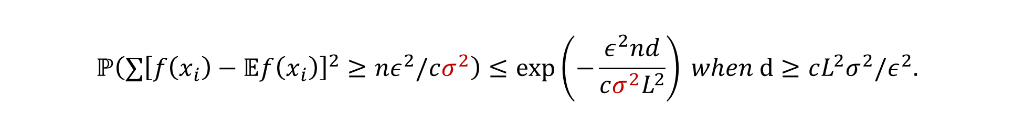
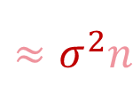
Remaining Parts
[4] Improved bounds for large dimension
$$ℙ\left(\frac{1}{n}∑z_{i}\left[f\left(x_{i}\right)−𝔼f\left(x_{i}\right)\right]≥ε/8\right)≤\exp\left(−\frac{ε^{2}nd}{cσ^{2}L^{2}}\right) when d≥cL^{2}σ^{2}/ε^{2}.$$
Key insight: Previously we treat $z_{i}\left[f\left(x_{i}\right)−𝔼f\left(x_{i}\right)\right]$ as a whole, now we separate them by
$$∑z_{i}\left[f\left(x_{i}\right)−𝔼f\left(x_{i}\right)\right]≤\sqrt{∑{\left[f\left(x_{i}\right)−𝔼f\left(x_{i}\right)\right]}^{2}}\sqrt{∑z_{i}^{2}}$$
Sub-exponential RV
$$≈σ^{2}n$$
Again, concentration leads to
$$ℙ\left(∑{\left[f\left(x_{i}\right)−𝔼f\left(x_{i}\right)\right]}^{2}≥nε^{2}/cσ^{2}\right)≤\exp\left(−\frac{ε^{2}nd}{cσ^{2}L^{2}}\right) when d≥cL^{2}σ^{2}/ε^{2}.$$
高等机器学习 Advanced Machine Learning
神经网络表示 Representation for Neural Networks
滕佳烨 Jiaye Teng, 上海财经大学 SUFE

Slide 30
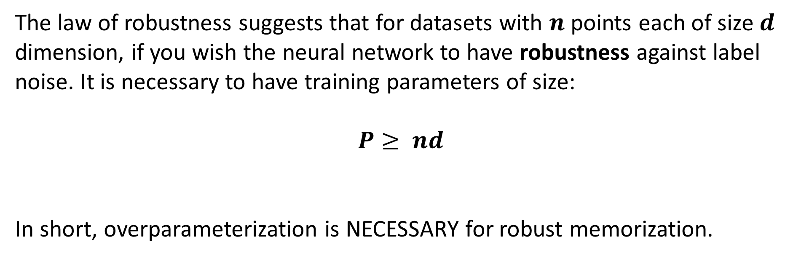
Law of robustness
The law of robustness suggests that for datasets with $n$ points each of size $d$ dimension, if you wish the neural network to have robustness against label noise. It is necessary to have training parameters of size:
$$P≥ nd$$
In short, overparameterization is NECESSARY for robust memorization.
高等机器学习 Advanced Machine Learning
神经网络表示 Representation for Neural Networks
滕佳烨 Jiaye Teng, 上海财经大学 SUFE

Slide 31
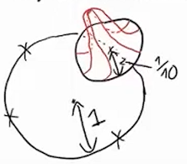
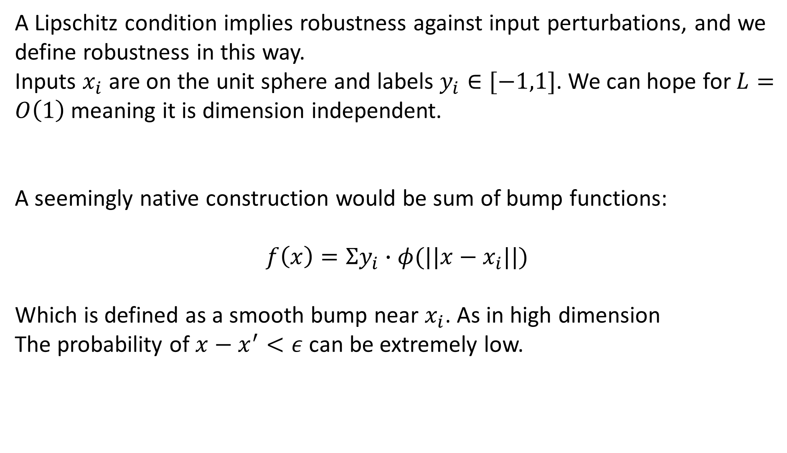
Law of robustness
A Lipschitz condition implies robustness against input perturbations, and we define robustness in this way.
Inputs $x_{i}$ are on the unit sphere and labels $y_{i}∈[−1,1]$. We can hope for $L=O\left(1\right)$ meaning it is dimension independent.
A seemingly native construction would be sum of bump functions:
$$f\left(x\right)=Σy_{i}∙φ(||x−x_{i}||)$$
Which is defined as a smooth bump near $x_{i}$. As in high dimension
The probability of $x−x^{′}<ε$ can be extremely low.
高等机器学习 Advanced Machine Learning
机器学习 Machine Learning
滕佳烨 Jiaye Teng, 上海财经大学 SUFE

Slide 32
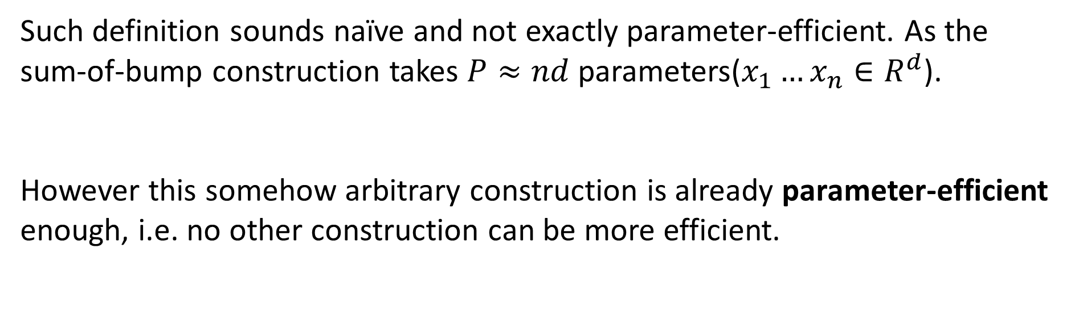
Law of robustness
Such definition sounds naïve and not exactly parameter-efficient. As the sum-of-bump construction takes $P≈nd$ parameters($x_{1}…x_{n}∈R^{d}$).
However this somehow arbitrary construction is already parameter-efficient enough, i.e. no other construction can be more efficient.
高等机器学习 Advanced Machine Learning
机器学习 Machine Learning
滕佳烨 Jiaye Teng, 上海财经大学 SUFE

Slide 33
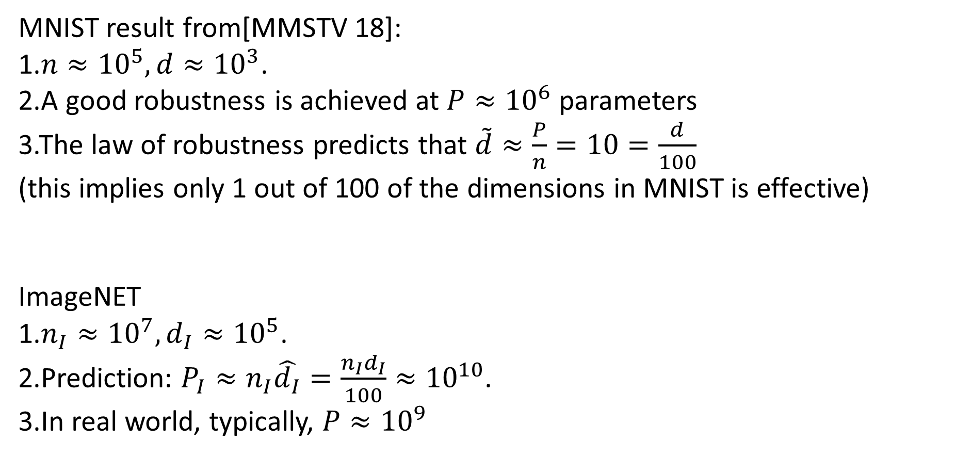
MNIST and ImageNET
MNIST result from[MMSTV 18]:
1.$n≈{10}^{5},d≈{10}^{3}$.
2.A good robustness is achieved at $P≈{10}^{6}$ parameters
3.The law of robustness predicts that $\tilde{d}≈\frac{P}{n}=10=\frac{d}{100}$
(this implies only 1 out of 100 of the dimensions in MNIST is effective)
ImageNET
1.$n_{I}≈{10}^{7}, d_{I}≈{10}^{5}$.
2.Prediction: $P_{I}≈n_{I}\hat{d_{I}}=\frac{n_{I}d_{I}}{100}≈{10}^{10}$.
3.In real world, typically, $P≈{10}^{9}$
高等机器学习 Advanced Machine Learning
机器学习 Machine Learning
滕佳烨 Jiaye Teng, 上海财经大学 SUFE

Slide 34
Take-away Messages
Robustness (Lipschitz) requires overparameterization
Hoeffding ineq, covering number, isoperimetry
Relates the theoretical results to the reality
高等机器学习 Advanced Machine Learning
神经网络表示 Representation for Neural Networks
滕佳烨 Jiaye Teng, 上海财经大学 SUFE

